Slide 1
US mask policy during COVID-19 evalution
ST 3003
Chuang Zhou
Jin Cui

Slide 2
01
The necessity of research
contents
02
Determine Effectiveness of Mask Mandates in each state
03
Find the factor that most affect the effect of the Mask Mandates
04
Conclusion

Slide 3
Part
01
The necessity of research

Slide 4
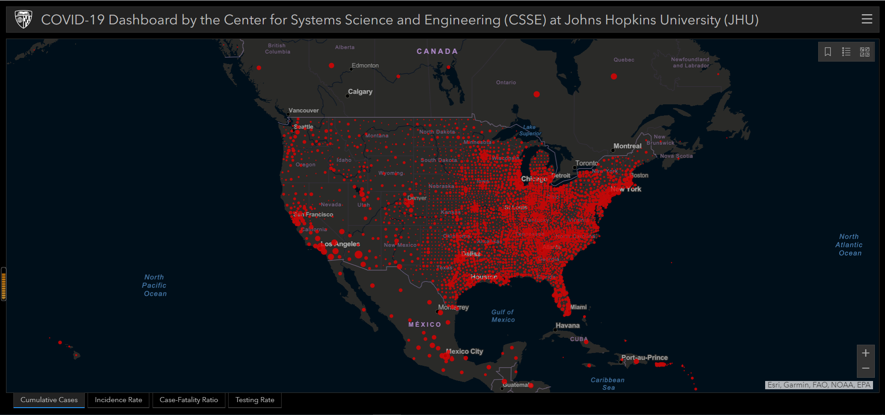

Slide 5
Background
SEVERE SITUATION:
At least 1,522 new coronavirus deaths and 62,690 new cases were reported in the United States on March 11.

Slide 6
Background
WHY WE CHOOSE THIS TOPIC

Slide 7
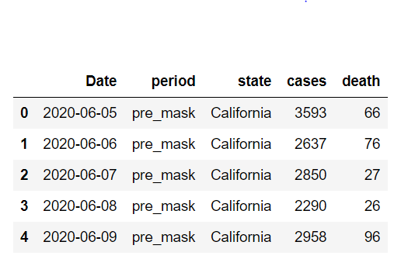
Background
Covid-19 Data Trends in Number and
Rates of Infections
http://seattle-data-dev.s3-website-us-west-2
.amazonaws.com/
https://www.nytimes.com/interactive/2020/
us/maryland-coronavirus-cases.html
The data format is shown in the figure.
We choose to use date and cases as the features of our dataset.
The third label we are going to analyze is wearing mask or not.

Slide 8
Part
02
Determine Effectiveness of
Mask Mandates in each state

Slide 9
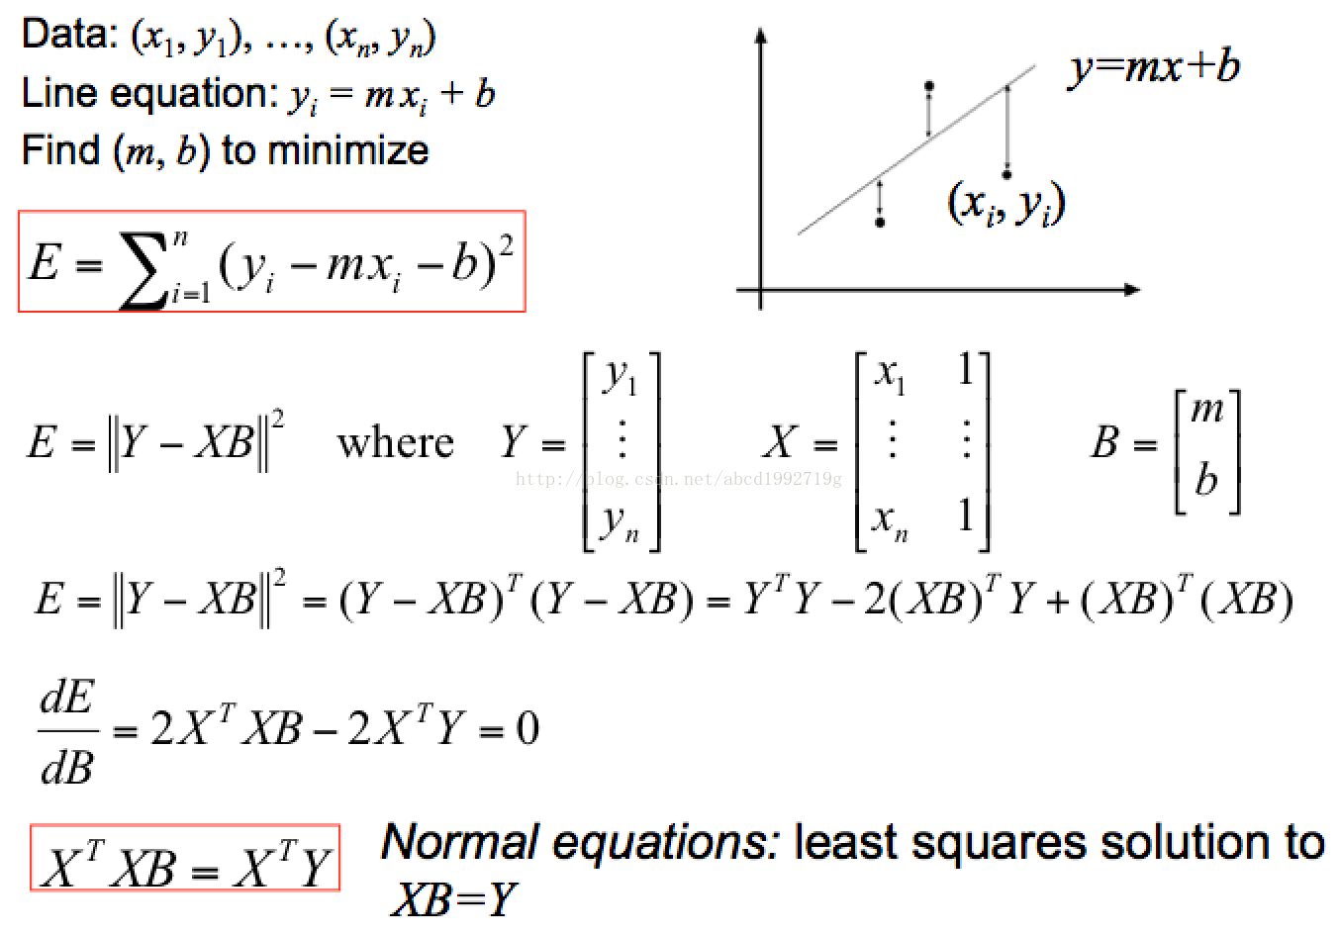
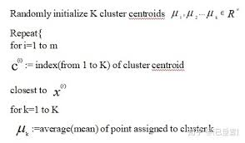
Methods
We use LES algorithm and k-means classifier to divide groups and evaluate the data feature.

Slide 10
Data analysis
dimension
comparison
classification

Slide 11
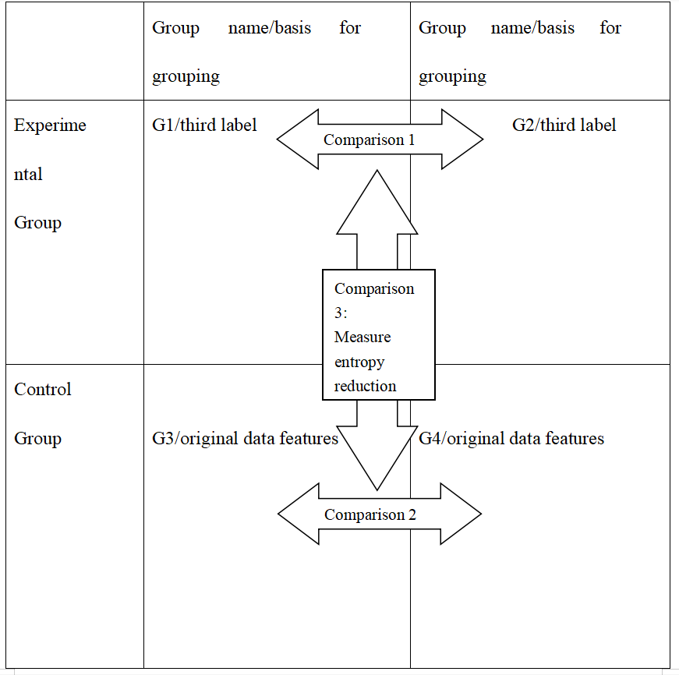
Data analysis

Slide 12
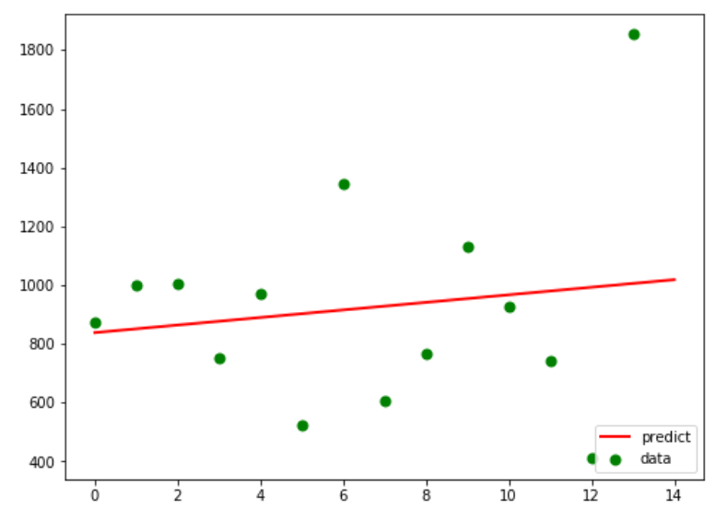
Group setting
Experimental group:
1.using linear fitting to reflect the features of the data set respectively
2.analyze the parameters of the fitting curve(variation factor : delta k).

Slide 13
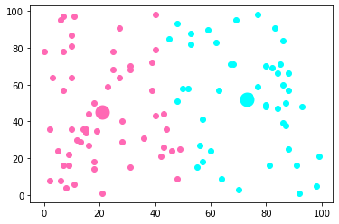
Group setting
Control group:
1. exclude the influence of other factors
2. Linear fitting is used to reflect the features of the data set respectively, and the parameters of the fitting curve are analyzed(variation factor : delta k).

Slide 14
Group setting
DIFFERENCE BETWEEN GROUPS
INFORMATION ENTROPY
WHAT IT STANDS FOR

Slide 15
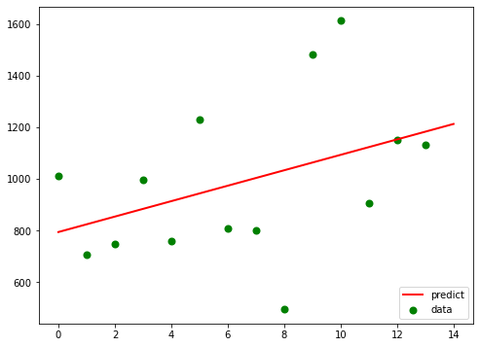
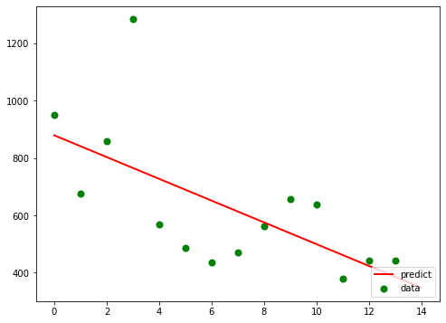
LES result
Example state：Virginia
before mandating mask policy:
y1 = 29.91868x + 793.6
after mandating mask policy:
y2 = -37.95165x + 878.82857
|k2-k1| = 67.87032967032962

Slide 16
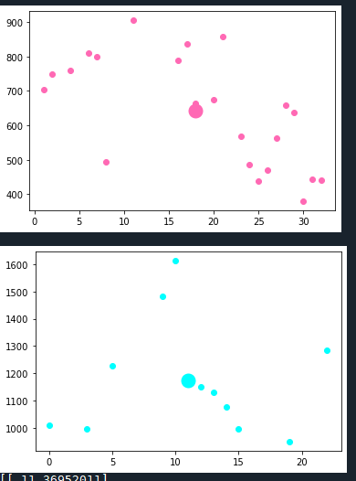
K-means clustering result
Example state：Virginia
Group1 LES result:
y1 = -11.13278816x + 853.98948598
Group2 LES result:
y2 = -6.11191099 + 1265.46531414
|K2-K1| = 5.02087717
(67.87-5.02)/67.87 = 92.6%>>50%
the policy corresponding
to this label(mask mandatory) is indeed effective

Slide 17
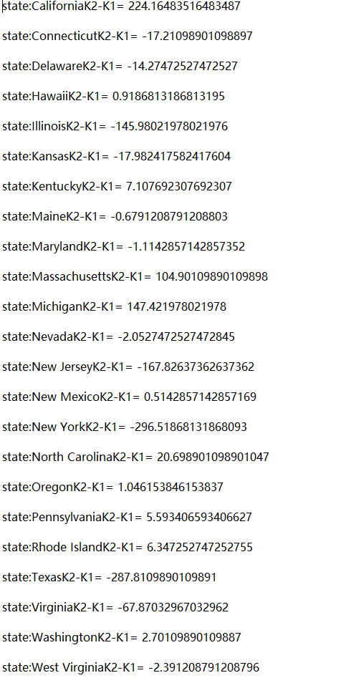
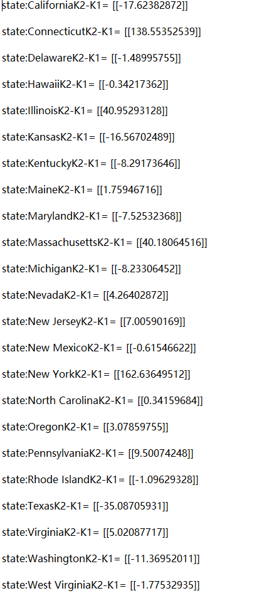
Comparison result
without mask label kmeans clustering and
LES result
with mask label LES result

Slide 18
Comparison result
states contain label LES result:
average |k2-k1| = 67.0925
states without mask label kmeans clustering and
LES result:
average |k2-k1| = 22.7526
(67.0925-22.7576)/67.0925 = 66.08% >50%
It indicates that mandating masks had a positive impact on epidemic
control. On the whole, it had played its role pretty well.

Slide 19
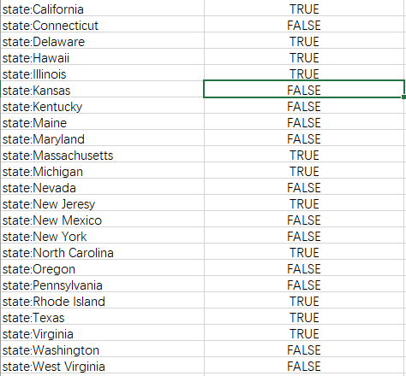
Comparison result
This table shows that each state's mask policy efficiency
compared to 50%(TRUE is higher):

Slide 20
Part
03
Find the factor that most affect the effect of the Mask Mandates

Slide 21
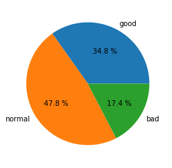
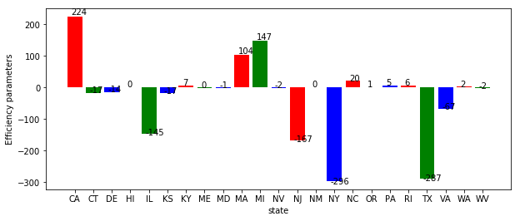
Data analysis
States were classified according to Efficiency parameters, with parameters less than -10 as good, parameters greater than 10 as bad, and the rest as normal
average of Efficiency parameters:-21.752030578117534
Mandates do help some states to control the COVID-19, but are also less helpful in some states.
According to the average of Efficiency parameters, mandates play positive roles in controlling the COVID-19.

Slide 22
Relevant factors
Viruses can survive longer in cold temperatures, which increases the chance that people will be exposed to them
Temperature
More staffed bed can contain more patients in the hospitals instead of isolating at home
Staffed bed
The higher the infection rate, the greater the chance that people will come into contact with a sick person
Infection rate
High density means that it’s more difficult for people to keep social distancing
Population density

Slide 23
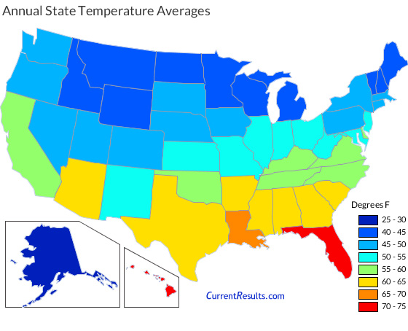
Classification standard
To get the relative temperature difference in each state, we divide the states into three categories by their temperature ranks.
Rank <=16: Hot
17<Rank<=34: Warm
Rank>34: Cold
https://www.currentresults.com/Weather/US/average-annual-state-temperatures.php

Slide 24
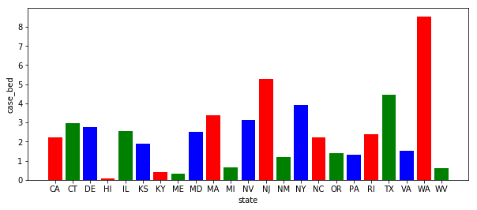
Classification standard
Cases per bed<=1.5: Vacant
1.5<Cases per bed<=3.5:Normal
Infection>3.5: Redundant
Use the state’s total cases in a month to divide the summation of staffed beds in the state, then get the cases per bed. Then use all the cases per bed in different state to classify each state.
https://www.ahd.com/state_statistics.html

Slide 25
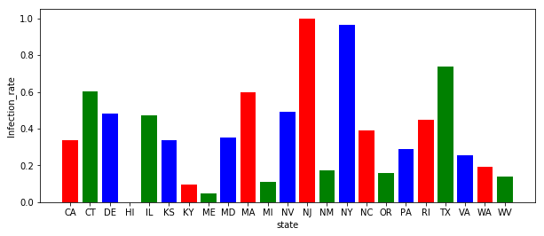
Classification standard
Infection rate <=0.2: Low
0.2<Infection rate<=0.45: Medium
Infection>0.45: High
Use the state’s total cases in a month to divide the population of the state, then get the infection rate. Then use all the infection rate in different state to do a normalization. Finally, use the updated infection rate to classify each state.
https://www.infoplease.com/us/states/state-population-by-rank

Slide 26
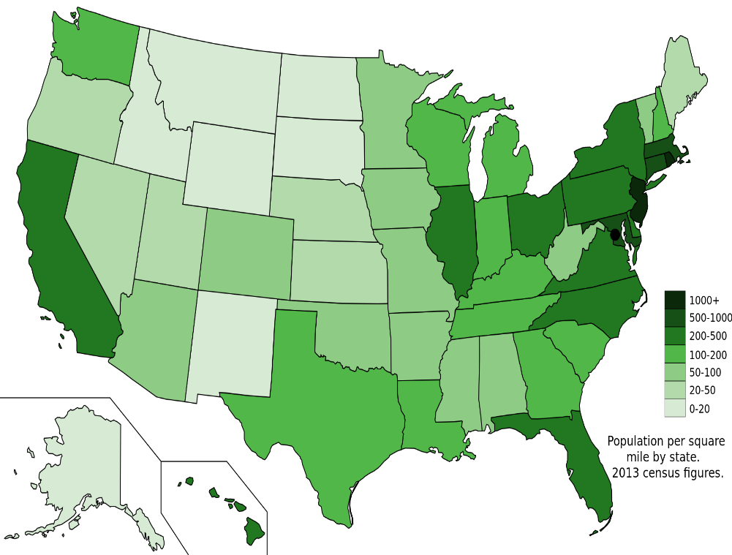
Classification standard
To get the relative population density difference in each state, we divide the states into three categories by their number of residents per square mile.
Number <=100: Low Density
100< Number <=250: Normal Density
Number >250: High Density
https://en.wikipedia.org/wiki/List_of_states_and_territories_of_the_United_States_by_population_density

Slide 27
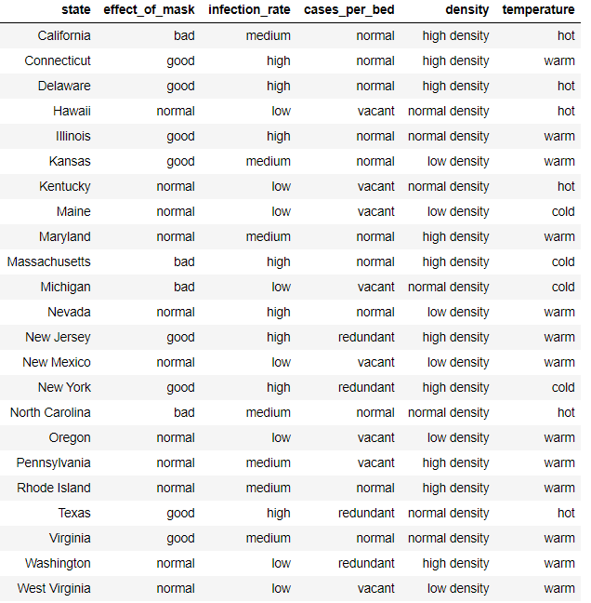
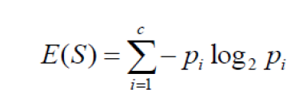
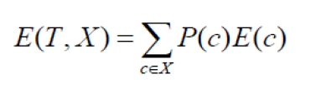
ID3
Use ID3 to draw the decision tree
This algorithm employs a top-down, greedy search through the space of possible branches with no backtracking
A decision tree is built top-down from a root node and involves partitioning the data into subsets that contain instances with similar values.ID3 algorithm uses entropy to calculate the homogeneity of a sample. If the sample is completely homogeneous the entropy is zero and if the sample is equally divided, then it has entropy of one.

Slide 28
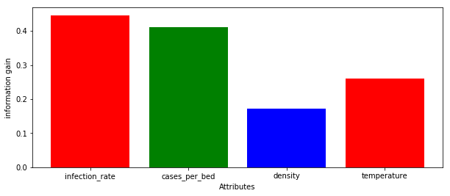
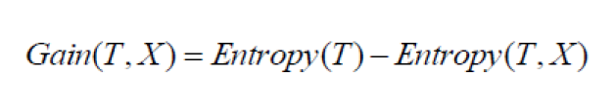
Information gain
From the first step of research, we can discover that the infection rate could most affect the effect of the mask mandates.

Slide 29
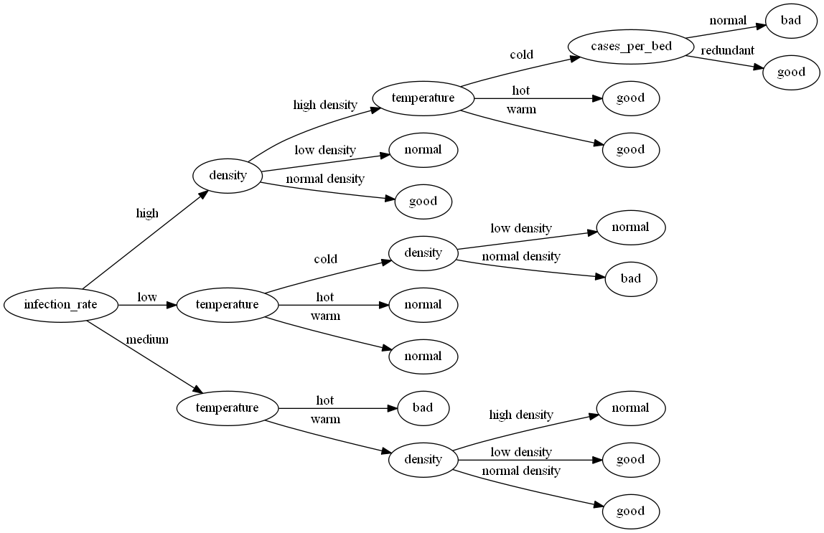
Decision tree

Slide 30
Part
04
Conclusion

Slide 31

Conclusion
Even though some data shows that the new cases per day somehow still increased after mandating mask , we think it indeed had a positive effect on preventing the pandemic.The reason why new cases are still increasing in someplace is due to other unknown factors and we managed to eliminate its effect.
01

Slide 32
Conclusion
According to the efficiency parameter, wearing mask do help to control the COVID-19 in general, so, government should keep this mandate until epidemic is over.
02
According to the decision tree, mask mandates have great effect when the state has high infection rate, which remind the government in high infection rate region to take more strict measures to require people to wear masks
03
Temperature not only affect the remaining time of the virus, but also can affect the degree of compliance with mandates. If government or companies develop a kind of mask which can alleviate the uncomfortable sense during the hot weather, the effect of mandates can increase.
04
05
The population density plays different roles in different precondition. We need do more study about that to make government’s policies effective.

Slide 33
Thanks for listening

